Slide 1

END-END MOVIE RECOMMENDATION SYSTEM USING MACHINE LEARNING
Guided By:
Mr. Purushottam Sharma
Submitted By:
Krishna Chaudhary
Himanshu Joshi

Slide 2
END-END MOVIE RECOMMENDATION SYSTEM USING MACHINE LEARNING
By
KRISHNA CHAUDHARY
HIMANSHU JOSHI
Under the guidance of
Mr. PURUSHOTTAM SHARMA
TRAINER, MACHINE LEARNING AND DEEP LEARNING
Department of Data Analytics and Machine Learning
Imarticus Learning

Slide 3
ACKNOWLEDGEMENT
I would like to thank my institute “IMARTICUS LEARNING, NEW DELHI” for giving me this opportunity of doing a project to gain practical experience to enable myself by understanding the demand of professional environment.
I express my deep sense of gratitude to Mr. Purushottam Sharma (Trainer) and all my Trainers guidance, suggestions had been source of my inspiration & were very helpful during my project.
I am even Grateful to Mr. Eshank Aggarwal (Trainer) for providing valuable feedback.
Thank You,
Krishna Chaudhary & Himanshu Joshi

Slide 4
Flow of Agenda
Part-1 Introduction to Project
Part-2 Project-Planning & Requirement
Part-3 Application Deployment
Part-4 Biblo-Graphy

Slide 5
Part-1 Introduction to Project

Slide 6
Introduction
Everyone loves movies irrespective of age, gender, color, or geographical location. The most interesting fact which I found is how we all are connected via this medium and yet how unique our choices and combinations are. It is difficult to say that everyone would like a particular movie because some people like thriller, romance or some people like sci-fi genres movie, while few people like lead actors and directors.
So, here’s where a role of data analyst come, we extract all the patterns based on user’s behaviour and from the data(movie) itself. So, without any further delay let’s jump and discuss our recommendation system.

Slide 7
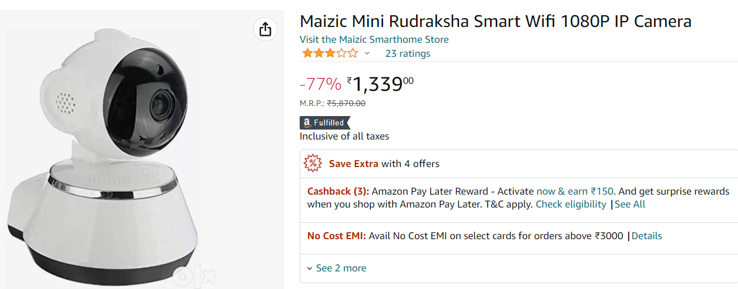
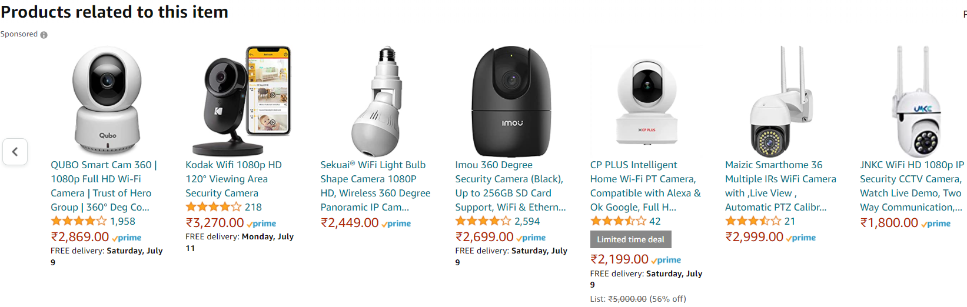
Use-Cases of Recommendation System
There are many use-cases of it. Some are
A. Personalized Content: Helps to Improve the on-site experience by creating dynamic recommendations for different kinds of audiences like Netflix, Amazon Prime does.
B. Better Product search experience: Helps to categories the product based on their features. For example: Amazon, Flipkart, etc.

Slide 8
What are Recommendation System?
In a simple words a Recommendation System is a filtration program whose primary goal is to predict the “preference” or “rating” of a user towards a specific domain. In our case, this is domain-specific recommendation system, where we will predict only those movie which user would prefer based on data of his/her choice.

Slide 9
Types of Recommendation System
Content-Based Filtering
Collaborative-Based Filtering
Hybrid-Based Filtering

Slide 10
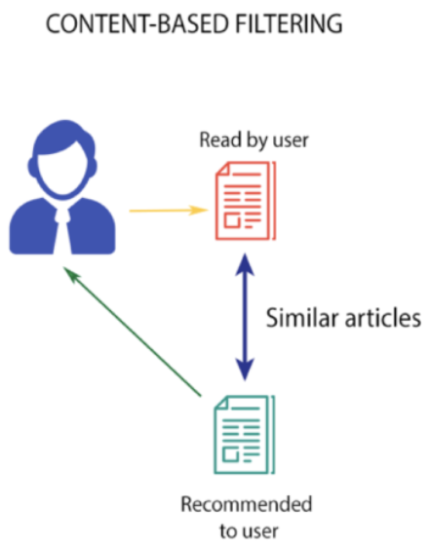
Content-Based Filtering
In this filtration strategy the algorithm recommends products which user has liked in the past. For example, if the user likes sci-fi movies like spider-man then we can recommend other marvels movie like Dr. Strange.

Slide 11
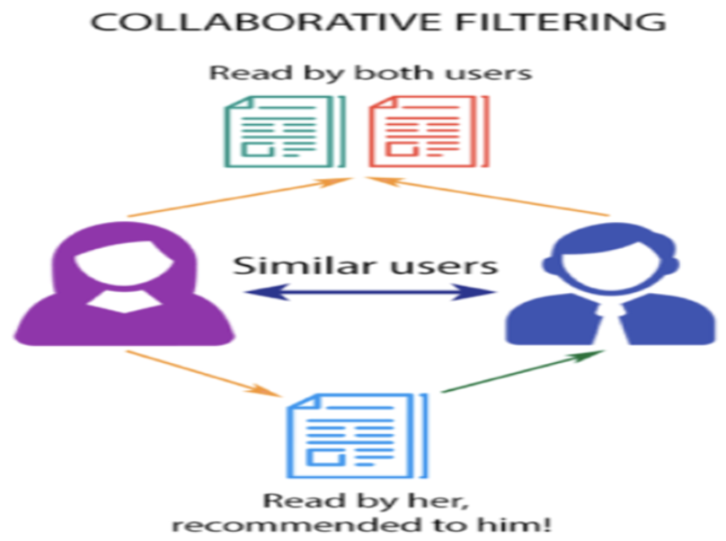
Collaborative-Based Filtering
This filtration strategy is based on the combination of user’s interest and compare it with other user’s interest. The history of all the users plays an Important role here. For example, if user ‘A’ likes ‘Thor’ and ‘Batman’ and the user ‘B’ likes ‘Batman’ and ‘Justice League’ then they have similar interests because these movies belong to super-hero genre. So, there are high probability that the user ‘A’ would like ‘Justice League’ and the user ‘B’ would like’s ‘Thor’

Slide 12
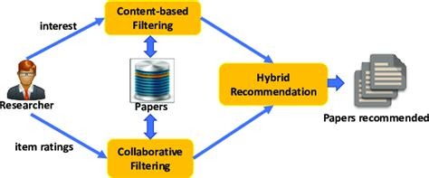
Hybrid-Based Filtering
This filtration strategy is based on the combination of user’s interest and compare it with other user’s interest. The history of all the users plays an Important role here. For example, if user ‘A’ likes ‘Thor’ and ‘Batman’ and the user ‘B’ likes ‘Batman’ and ‘Justice League’ then they have similar interests because these movies belong to super-hero genre. So, there are high probability that the user ‘A’ would like ‘Justice League’ and the user ‘B’ would like’s ‘Thor’.

Slide 13
Part-2 Project-Planning & Requirement

Slide 14
Project Flow
Platform that enables developers to build, run and operate applications entirely in the cloud
Data Collection
Process of gathering and measuring information on variable of interests
Pre-Processing
ML Model
To Website
A preliminary processing of data in order to prepare it for further analysis
Can be understood as a program that has been trained to find patterns within new data and make predictions
Will be used as a frontend technology to help user’s to interact with application
Deploy
1
2
3
4
5

Slide 15
About Dataset
This is a TMDB 5000 Movie Dataset. There are two csv files.
Movies: The movie dataset contains information of movies in which we have different columns like genres, homepage, id, keywords etc.
Credits: The credits dataset contains information of cast and crew with the name of movie in which they have worked.

Slide 16
Movie Dataset
budget | genres | homepage | id | keywords | original_language | original_title | overview | popularity | production_companies | production_countries | release_date | revenue | runtime | spoken_languages | status | tagline | title | vote_average | vote_count
237000000 | [{"id": 28, "name": "Action"}, {"id": 12, "nam... | http://www.avatarmovie.com/ | 19995 | [{"id": 1463, "name": "culture clash"}, {"id":... | en | Avatar | In the 22nd century, a paraplegic Marine is di... | 150.437577 | [{"name": "Ingenious Film Partners", "id": 289... | [{"iso_3166_1": "US", "name": "United States o... | 2009-12-10 | 2787965087 | 162.0 | [{"iso_639_1": "en", "name": "English"}, {"iso... | Released | Enter the World of Pandora. | Avatar | 7.2 | 11800

Slide 17
Credits Dataset
movie_id | title | cast | crew
19995 | Avatar | [{"cast_id": 242, "character": "Jake Sully", "... | [{"credit_id": "52fe48009251416c750aca23", "de...
285 | Pirates of the Caribbean: At World's End | [{"cast_id": 4, "character": "Captain Jack Spa... | [{"credit_id": "52fe4232c3a36847f800b579", "de...
206647 | Spectre | [{"cast_id": 1, "character": "James Bond", "cr... | [{"credit_id": "54805967c3a36829b5002c41", "de...
49026 | The Dark Knight Rises | [{"cast_id": 2, "character": "Bruce Wayne / Ba... | [{"credit_id": "52fe4781c3a36847f81398c3", "de...
49529 | John Carter | [{"cast_id": 5, "character": "John Carter", "c... | [{"credit_id": "52fe479ac3a36847f813eaa3", "de...

Slide 18
Approach of Problem
This project is based on Content-based Filtering methodology. We will create tags using columns like ‘genres’, ‘keyword’, ‘cast’, ‘crew’ etc.
First we will combine both dataset into single dataset.
Then we will extract only those columns which will be helpful in creating tags. Once that done then we proceed for data pre-processing, in which we will do data cleaning, and converting it to useful insight like extracting names of top actors from cast column and converting it to list etc.
After that we will make Machine Learning model in which we will convert texts to vectors i.e TextVectorization using BagofWords and then we will use “Cosine Similarity” to calculate distance between movies. After completing this our Machine Learning model is ready.
Now the final part is to make a website and deploy the project.

Slide 19
Necessary Packages
Ast
Pandas
Sklearn
Pickle
Requests
CountVectorizer
Cosine Similarity

Slide 20
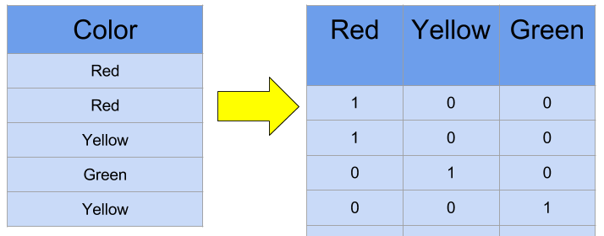
Example of Count Vectorizer

Slide 21
Cosine Similarity
2 Dimensional Space
Suppose we have a 2 Dimensional space and we plot all the tags into it, then it will look like graph 1.
After converting it to vectors it will look like graph 2.
Now based on the user’s choice we will recommend movie (Vectors) which is have the least distance.
Y
Tag 1 (2,5)
Y
V1 (2,5)
Tag 2 (7,5)
V2 (7,5)
X
X
Tag 3 (3,9
V3 (3,9)

Slide 22
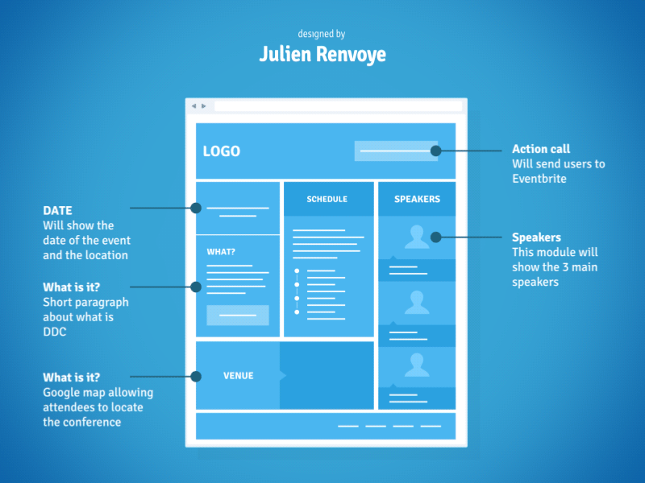
What is framework?
A framework is a structure that you can build software on. It serves as a foundation, so you're not starting entirely from scratch.

Slide 23

Streamlit Framework
Streamlit is an open-source Python library that makes it easy to create and share beautiful, custom web apps for machine learning and data science. In just a few minutes you can build and deploy powerful data apps.

Slide 24
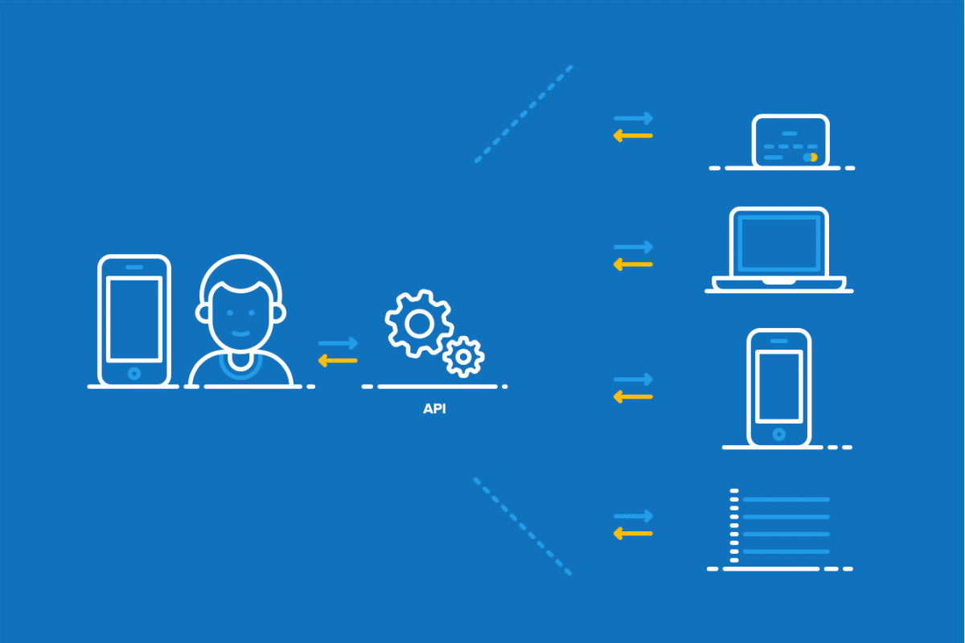
What is API
API is the acronym for Application Programming Interface, which is a software intermediary that allows two applications to talk to each other. Each time you use an app like Facebook, send an instant message, or check the weather on your phone, you're using an API.

Slide 25
Design of Web Application
Title of the Application
Text Area
Search Area
Recommendation Button
Movie 1 Title
Movie 1 Title
Movie 1 Title
Movie 1 Title
Movie 1 Title
Movie 1 Poster
Movie 1 Poster
Movie 1 Poster
Movie 1 Poster
Movie 1 Poster

Slide 26
Part-3 Application Deployment

Slide 27

Heroku
Heroku is a platform as a service (PaaS) that enables developers to build, run, and operate applications entirely in the cloud.
Heroku is very user-friendly and easy to deploy your application in just few steps.

Slide 28
Required files for deploying to Heroku
Before deploying any application on Heroku we need 4 different types of files inside the project folder.
.gitignore : When sharing your code with others, there are often files or parts of your project, you do not want to share.
Procfile : Procfile specifies the commands that are executed by the app on startup
Requirements.txt : stores all files and packages on which that project is dependent or requires to run.
Setup.sh : This is a shell file this will create a streamlit folder with credentials.toml and a config.toml file.

Slide 29
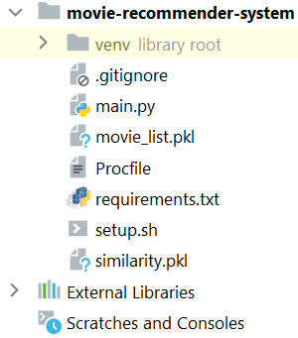
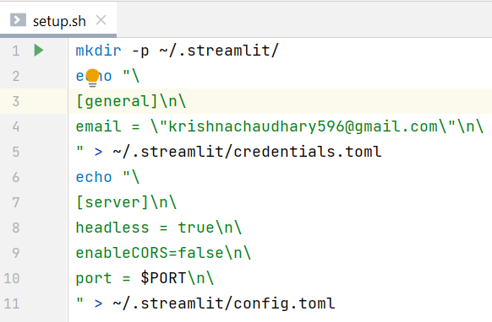
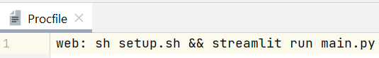
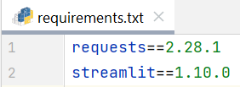
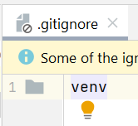
Files & Structure

Slide 30
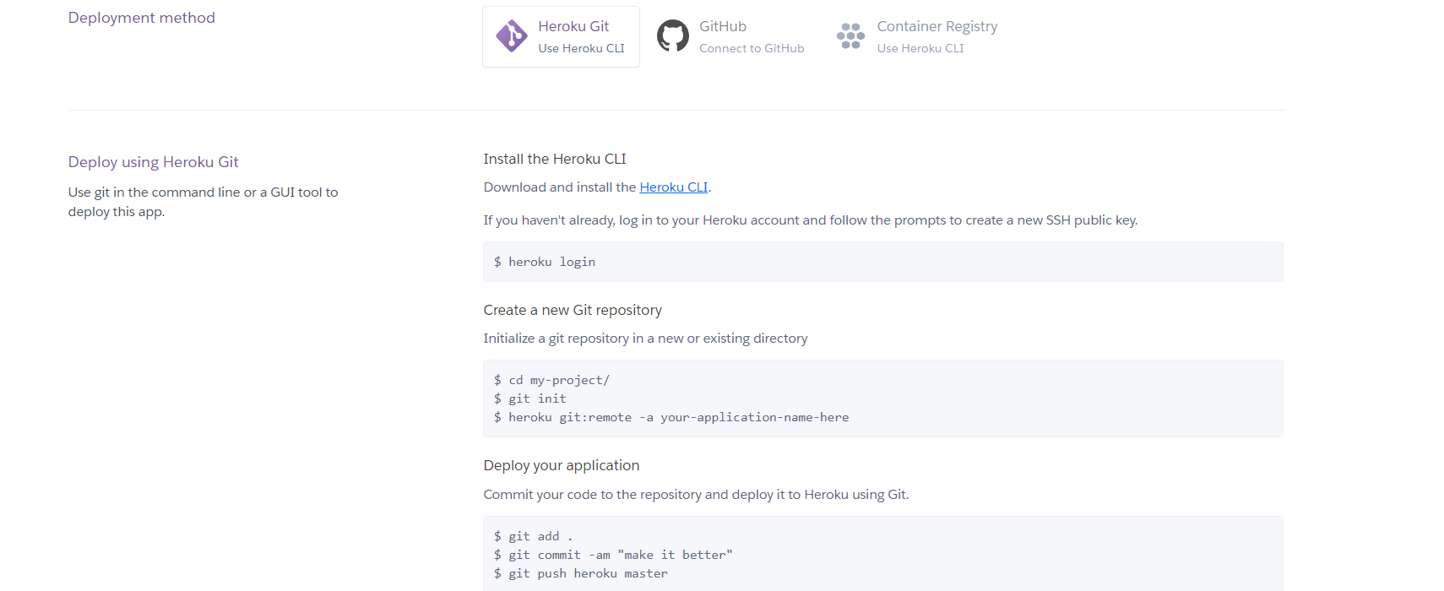
Steps to deploy application on Heroku

Slide 31

The Web Application

Slide 32
Future Work
Coming for future upgradation :
We can work more on frontend part.
We can include sentiment analysis of reviews for selected movies.
We can include searching based on genres, popularity etc.

Slide 33
Part-4 Biblography

Slide 34
Tools & Technology
Frontend : Streamlit
Backend : Python
IDE’s : Visual Studio Code & PyCharm

Slide 35




Thank You
Krishna Chaudhary
Himanshu Joshi
https://linktr.ee/krishna.chaudhary

